Slide 1
Heat Stress
Safety Meeting Topics
Copyright by the Institute for Safety in Powerline Construction
3504 Parliament Ct.
Alexandria, LA 71303
All rights reserved. This material or any part thereof
may not be reproduced in any form without
the written permission of the
Institute for Safety in Powerline Construction
©
Notes:
Slide Show Notes

Slide 2
Heat Stress
When the body is unable to cool itself by sweating.
Several heat-induced illnesses can occur.
Heat rash
Heat cramps
Heat exhaustion
Heat stroke (most severe)
Notes:
Heat related injuries and illnesses are considered a hazard to powerline construction and maintenance workers. These types of hazards are often ignored until a worker is injured or becomes ill from the heat induced hazards. Consequently, the possibility of heat induced hazards should be discussed during the ‘Tail-Board’ or Pre-Job Briefing. The hazard should be identified and then mitigation plans should be put into place, prior to the work beginning. Additionally, how to treat for each of these injuries or illnesses should be part of every Emergency Action Plan (EAP).

Slide 3
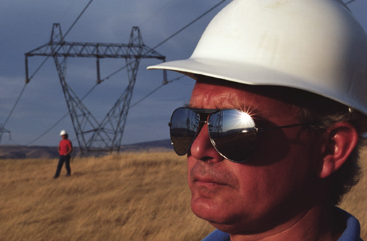
Hot work environments
Routine work by powerline crews in the summer months
Emergency restoration work most times of the year
Strenuous work anytime
Direct exposure to the summer sun
for long periods
Working in confined spaces
Over-exertions
Proximity to heated equipment
Notes:
We often only consider heat induced hazards during the summer months when concerned about the high temperatures. Summer temperatures are only one of the factors that can cause heat related injuries and illnesses.

Slide 4
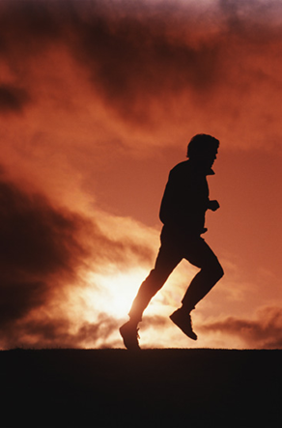
Risk factors
Not everyone is affected equally
age, weight, physical fitness
metabolism, medications, use of alcohol/drugs
Air temperature
Humidity
Elevation
Rubber insulating PPE
FR, Other protective clothing
Notes:
Everyone responds to heat related hazards differently. Workers will have a different tolerance to heat related conditions for a variety of reasons. This is one reason we need to observe one another routinely to see how these heat hazards may be affecting our co-worker. We may feel fine and assume that everyone else does too.

Slide 5
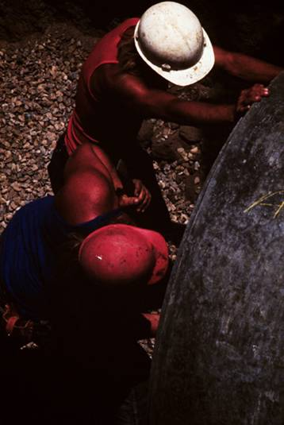
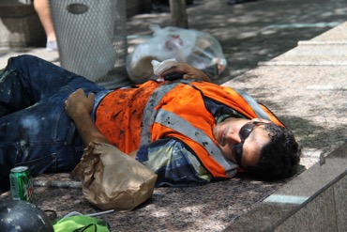
How heat causes fatigue
Blood circulates to upper layers of skin
Less blood is available to provide energy to active muscles, brain, internal organs
Performance, coordination, alertness all decline
Often, symptoms come upon us
gradually
Notes:
Since heat related injury and illness symptoms often appear gradually, it’s important to watch others for the onset of symptoms. The sooner we can help a victim, the quicker the recovery.

Slide 6
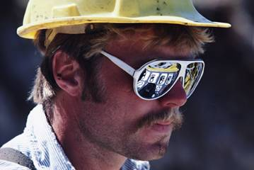
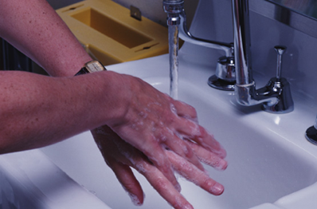
Heat rash
Results from body’s natural cooling mechanisms
Body heat is released through sweating
If sweat ducts become obstructed, a rash can develop
Rash may be dangerous, can become infected
Rest in a cool area
Bathe and dry the skin ASAP
Notes:
A bright red appearance to the skin and/or a red rash on the skin may signal the onset of symptoms. It’s normal to sweat and is the body’s way of cooling itself down. When this doesn’t happen fast enough a ‘heat rash’ may occur. This is the lowest category of heat-related illness. Stop work, move to a cool area, drink fluids and dampen the skin with cool water. The victim should recover within 30 to 45 minutes. If not, medical attention may be required.

Slide 7
Fainting
Fainting can be a reaction to the heat
As blood is circulated to extremities, it can accumulate in the lower part of the body
Fainting can occur if the brain does not get enough blood
Lie down in a cool area
Recovery position for a person who has fainted
Notes:
Fainting may occur at any point when the worker is experiencing heat related problems. Fainting can be a sign of other problems as well. Call for emergency medical assistance, especially if the worker does not regain consciousness quickly.

Slide 8
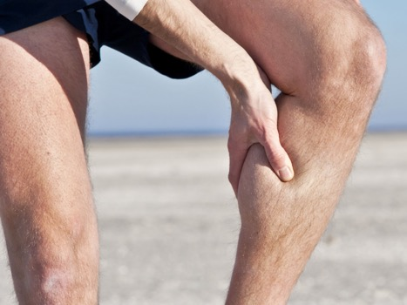
Muscle cramps
Occur in tired muscles when worker sweats profusely and drinks large amounts of water
Sweating removes salt from the body
Drinking dilutes body fluids
Low salt levels can cause painful spasms
Too much salt can also cause cramps
Notes:
Muscle cramps are an early sign of the body trying to cope with over-exertion, lack of hydration and possibly a lack of salt or other minerals the muscles need to properly function. This early sign is a warning – slow down, rest, cool off, drink some Gatorade or similar product.

Slide 9
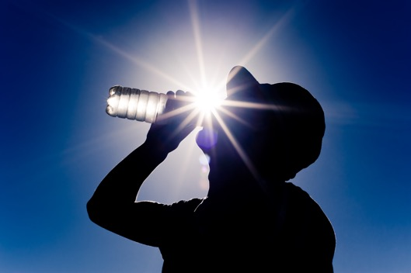
Muscle cramps (cont.)
Drink 5 to 7 ounces of water every 15 to 20 minutes
Thirst is not a reliable indicator of the need for water in a hot environment
Avoid drinking beverages containing caffeine or alcohol
Notes:
Oddly, workers may not feel thirst at the same time their bodies are dehydrating and in desperate need of water. Routine intake of water is best, whether thirsty or not, when exposed to heat related hazards.

Slide 10
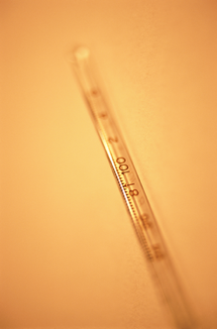
Heat Exhaustion
Results when a person has lost large amounts of fluid by sweating
Symptoms resemble early heat stroke
Fatigued
Giddy
nauseous
Headache
Notes:
Heat exhaustion is an advanced stage of heat related illness that must be dealt with quickly. During this stage, the worker will feel exhausted, not quite as alert as normal and may complain of a headache. Immediate treatment is required and is likely to require medical attention.

Slide 11
Heat Exhaustion (Cont.)
Symptoms (cont.)
Profuse sweating
Skin is clammy and moist
Body temperature remains at or near normal
Victim may vomit/lose consciousness in extreme cases
Move victim to cool place and give plenty of liquids

Slide 12
Heat Stroke
Life-threatening condition
Occurs when body’s temperature regulatory system fails
Sweating becomes inadequate to remove excess heat
Skin is hot and dry
Body temperature is 105 degrees F or higher
Notes:
Heat stroke is the most dangerous stage of heat related illness and has the greatest potential for injury. The worker’s body has completely lost it’s ability to regulate heat internally and once the body temperature rises above 105 degrees and stays there or goes higher, brain damage can occur. Immediate emergency medical attention is required.

Slide 13
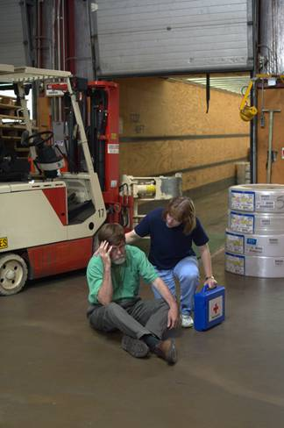
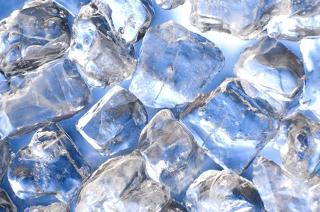
Heat Stroke
Victim is mentally confused or delirious
Victim may have convulsions or become unconscious
Get immediate medical attention
Move victim to cool area
Soak clothing in water
Fan the body
Never leave unattended

Slide 14
Measuring/evaluating heat exposures
Relative Humidity
Temperature
70%
100°F
37.8°C
Heat index system
Health and safety agency testing
60%
95°F
35°C
50%
90°F
32.2°C
40%
85°F
29.4°C
30%
80°F
26.7°C
Danger
Caution
Less Hazardous

Slide 15
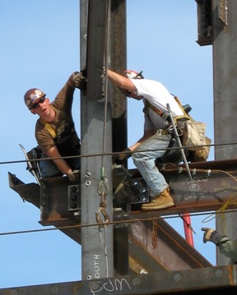
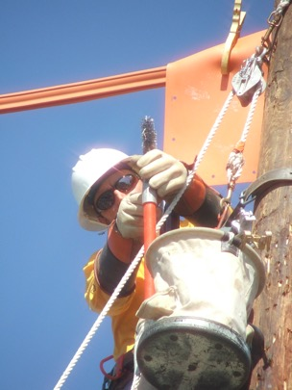
Measuring/evaluating heat exposures (cont.)
Work classifications:
Light hand work
Heavy hand work
Heavy work with one arm
Light work with two arms
Moderate work with the body
Heavy work with the body
Notes:
At the ‘Tail-board’ or Pre-Job Briefing discuss the physical work to be done and the conditions in which it is being done. Determine what general category, as shown in the slide, the work may fall. This will provide an idea of the level of hazard involved and what can be done to minimize the heat impact on the worker.

Slide 16
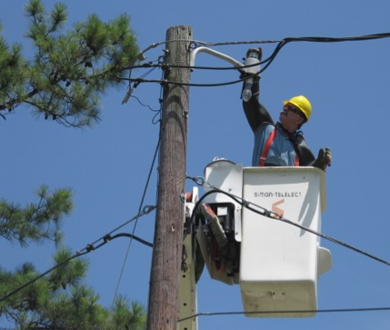
Controlling heat stress
Engineering controls
Work practice controls
PPE
Take intermittent rest periods with water breaks
Use relief workers
Pace the work
Notes:
Heat hazard mitigation can focus on one or more of the following.

Slide 17
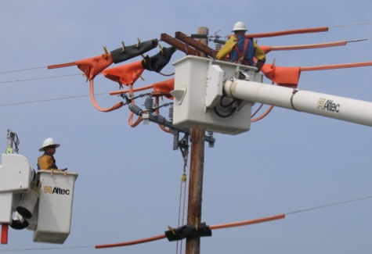
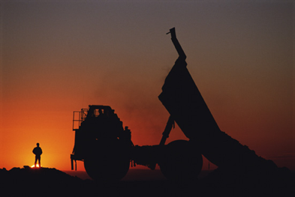
Controlling heat stress (Cont.)
Reduce physical demands
Use cool recovery or rest areas
Schedule work for cooler times of day

Slide 18
Any Questions?
Any Questions about:
Heat Stress risk factors
Heat related injuries
Measuring / evaluating heat exposures
Controlling heat stress

