Slide 1
Safety Meeting Topics
Hazard Assessment and Selection –
Personal Protective Equipment
Copyright by the Institute for Safety in Powerline Construction
3504 Parliament Ct.
Alexandria, LA 71303
All rights reserved. This material or any part thereof
may not be reproduced in any form without
the written permission of the
Institute for Safety in Powerline Construction

Slide 2
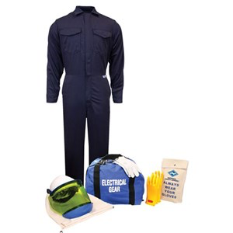
Session Objectives
You will be able to:
  Understand the PPE hazard assessment process
  Select appropriate PPE for the job
  Know how to properly wear and care for PPE
Notes:
Slide Show Notes
The main objectives of this training session are for you to be able to:
Understand how to conduct a PPE hazard assessment, including evaluating the workplace and job functions for any potential hazards that can be controlled by using PPE;
Select the appropriate PPE to protect against the hazards found during the hazard assessment; and
Show employees how to properly wear and care for PPE.

Slide 3


Hazard Assessment
Evaluate every job site, no matter how routine the job is
Determine if hazards are present
Check for hazards to
eyes, exposed skin, head, feet, hands and lungs
Determine what PPE will protect against hazards
Notes:
Slide Show Notes
A hazard assessment is essential to understanding the type of hazards employees might be exposed to, and should be conducted before selecting PPE. Here is an overview of how a hazard assessment is conducted:
First, evaluate every job function in every department for potential hazards.
Determine if there are hazards present for each job function, and record what these hazards are. A simple checklist showing a variety of possible hazards may be all that is required.
Use the checklist to determine if there are hazards to the eyes, respiratory system, hands, feet, head, or other parts of the body.
Finally, determine what type of PPE will protect against the hazards that are found. For example, if there is an eye hazard present, determine if safety glasses are adequate or whether workers need goggles.
Develop a simple checklist that includes the items listed on the following slides for each part of the body. Use the checklist to evaluate each job to determine if potential hazards are present.

Slide 4


Eye and Face Assessment
Flying particles
Arc flash
Liquid chemicals
Acid or caustic liquids
Chemical gases or vapors
Potentially injurious light radiation
Notes:
Slide Show Notes
Hazard assessments are conducted to protect each part of the body. Let’s start with the eyes and face.
Evaluate the workplace to see if employees are exposed to flying particles such as dust from grinding, metal chips from machine shop equipment, or wood chips from a cabinet shop. Flying particles cause the majority of eye injuries in the workplace.
Molten metal is a hazard to the eyes and face if employees are exposed to metal that could splash up and damage the eyes or burn the face.
Liquid chemicals are also a common eye and face hazard. Examples include aerosol cans, cleaning solutions, solvents for cleaning metal, spray adhesive, and spray paints; these might be splashed or sprayed into a worker’s face or eyes.

Slide 5
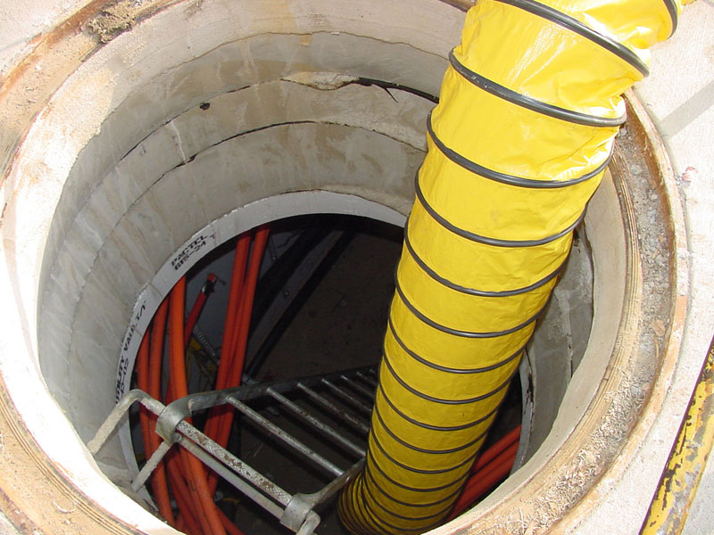

Respiratory Protection
Hazard Assessment
Assess the workplace:
Inhalation of airborne
dusts or particulates
Inhalation of chemical
vapors or fumes
Lack of adequate oxygen
Notes:
Slide Show Notes
Hazard assessments for respiratory protection should evaluate the following conditions:
Potential inhalation of airborne dusts or particulates, which might come from grinding, cutting, sanding, or welding operations. Other dusts might come from wood chips, grain, or other solid granular materials.
Inhalation of chemical vapors or fumes, which can come from a wide variety of operations involving chemicals. Using solvents, spraying with aerosols, painting operations, bulk handling, including loading or unloading, of chemicals are just a few examples of jobs that could result in inhaling chemical vapors or fumes.
Lack of oxygen, which can affect workers in confined spaces, usually refers to jobs in confined spaces where there may not be enough oxygen to enter without respiratory protection.
Think about the kinds of jobs and operations in your workplace that require respiratory protection.
Modify or delete this slide and the next slide as they apply or do not apply to your workplace.

Slide 6
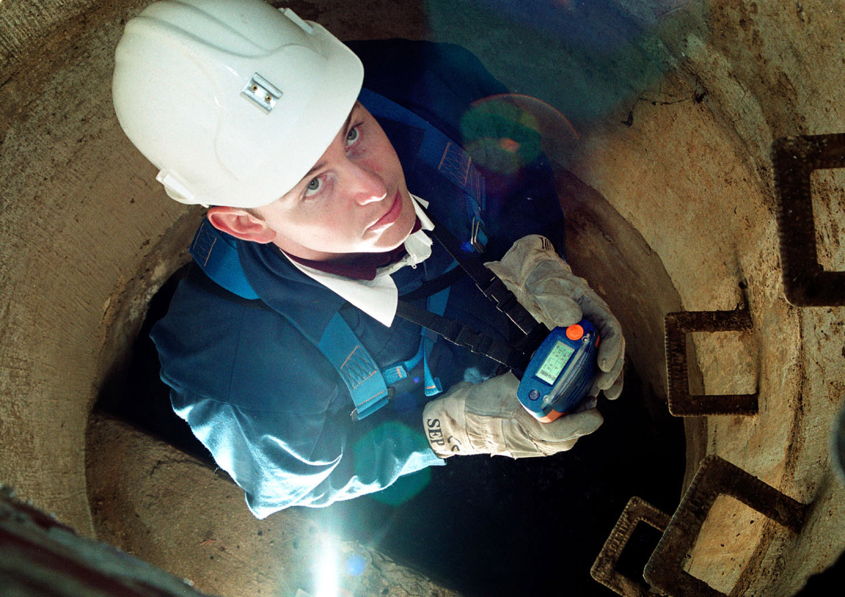
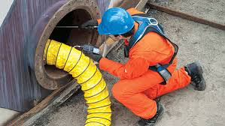
Respiratory Protection
Hazard Assessment (cont.)
Identify the specific source(s) of respiratory hazard
Review the work processes to determine the hazard source and magnitude
Monitor the exposure
Notes:
Slide Show Notes
After the assessment has identified the potential for exposure to dusts, chemical vapors, or lack of oxygen, it still needs to go further in taking the following steps:
Identify the specific sources of the respiratory hazard.
Review the work processes to determine where the exposures exist and the magnitude of the exposure.
And finally, monitor the exposure if necessary to measure the degree of the hazard.
Modify or delete this slide as it applies to your workplace.

Slide 7



Head Hazard Assessment
Falling objects
Exposed electrical
conductors
Low-hanging
obstructions
Notes:
Slide Show Notes
When assessing for head hazards, consider these possible causes:
Falling objects can be a major cause of head injuries. Determine if the job exposes workers to objects falling from above, such when there are employees in an area with other employees working above them on scaffolds or catwalks.
Exposed electrical conductors may be a hazard, requiring workers to wear appropriate hard hats—those that do not conduct electricity.
Finally, low-hanging obstructions present another head hazard, such as when an employee needs to walk or crawl under equipment to perform maintenance or cleaning.
These are the primary causes of head injuries. Can you think of any other potential head hazards specific to your workplace that are not listed on this slide?

Slide 8
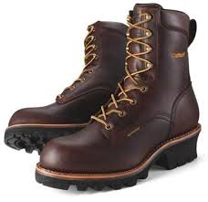
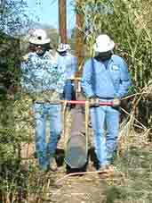
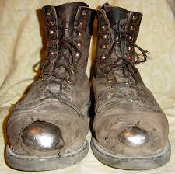
Foot Hazard Assessment
Falling, rolling, or sharp objects
Electrical hazards
Slippery walking surfaces
Hazardous chemicals
Cold weather conditions
Loading Poles
Climbing Poles
Notes:
Slide Show Notes
Your hazard assessment should not forget potential foot hazards. There are many possible hazards to feet:
Falling, rolling, or sharp objects that are dropped on feet by employees who handle heavy objects. In some workplaces, employees are exposed to heavy rolling objects such as large rolls of paper or forklift tires, which can crush someone’s foot. In some workplaces, there are sharp objects that might pierce the sole of your shoe and foot.
There may be electrical hazards in some workplaces that require employees to wear insulated footwear that contain no metal.
Slippery walking surfaces may cause falls. While a fall might not injure the a foot, slippery floors are considered a foot hazard because proper footwear is required to reduce the hazard.
Hazardous chemicals could be a foot hazard if there is a possibility of splashing them on the feet.
Finally, cold weather conditions can be a foot hazard if there is the possibility of frostbite.
These are the primary types and causes of foot injuries. Can you think of any other potential foot hazards specific to your workplace that are not listed on this slide?

Slide 9
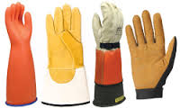
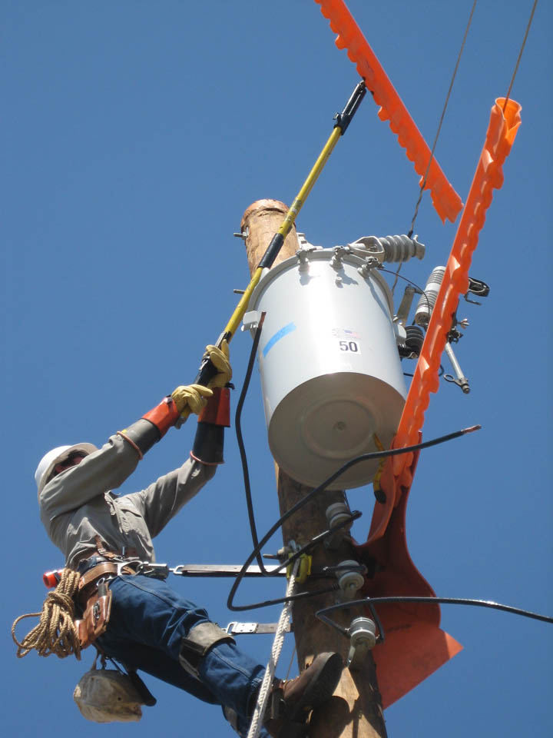
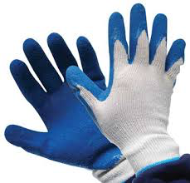
Hand Hazard Assessment
Skin absorption of harmful substances
Severe cuts or lacerations
Severe abrasions
Energized lines and equipment
Climbing wooden poles
Notes:
Slide Show Notes
A hand hazard assessment should be very comprehensive, because there so many different possible causes of hand injuries.
Skin absorption of hazardous substances often occurs through the hands. Check for the presence of hazardous chemicals that might be absorbed through the skin or otherwise cause skin damage.
Severe cuts and lacerations can result from working with machinery and equipment. These machines should have protective guarding, but employees still need to know about the possible hazards. Cutting equipment such as saws and drills can cause severe injury if a hand is placed near the point of operation. Hand tools can cause cuts and punctures. Even metal straps or wires used for packaging can cause severe cuts if not handled carefully.
Severe abrasions include scrapes, tearing of the skin, and removal of the skin by such items as sanders, grinders, conveyor belts, rotating shafts, scrap metal, and broken glass. Employees should know how to protect themselves against these kinds of hazards.

Slide 10
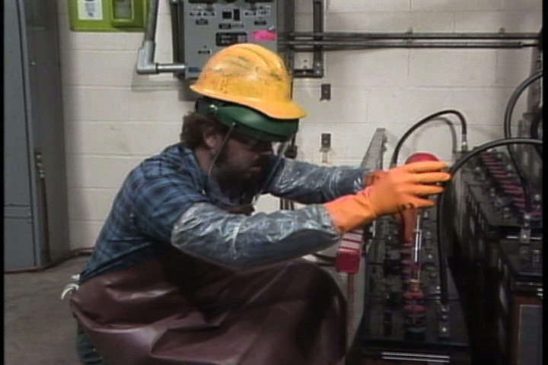
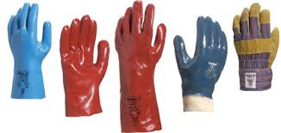
Hand Hazard Assessment (cont.)
Punctures
Chemical burns
Thermal burns
Notes:
Slide Show Notes
Other types of hand hazards include:
Puncture wounds, which can result from a wide variety of tools and equipment such as drills, nail guns, and even screwdrivers. Slivers of metal or wood can also cause deep punctures that can become infected.
Chemical burns can be caused by handling acids, caustics, and many strong chemicals. Depending on the concentration of the corrosive chemicals, chemical burns can be quite severe.
Finally, thermal burns—that is, burns from heat—can result from welding, cutting, and brazing operations. Steam equipment, such as a boiler, involve many extremely hot items such as pipes and tanks. Industrial ovens for baking, drying, or annealing present obvious thermal burn hazards.
Ask trainees to think of any other potential hand hazards specific to your workplace that are not listed on this slide. Other hazards might include repetitive motion or exposure to vibration.

Slide 11
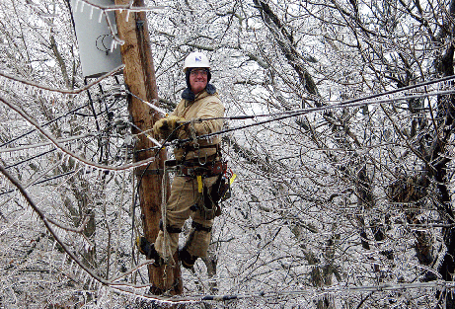
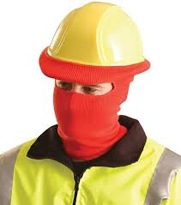
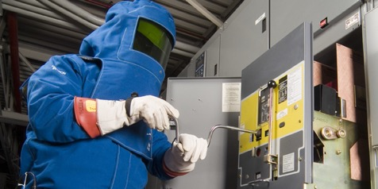
Clothing Assessment
Weather conditions
Chemicals
Arc flash hazards
Contact with energized parts/lines
Heavy, sharp, or
rough materials
Moving machinery
Notes:
Slide Show Notes
Evaluating hazards includes an assessment to determine proper clothing. Here are some of the hazards that require protective clothing:
Hot or cold materials or objects can cause skin damage. Employees who work around steam lines or in other hot environments, or those who work in refrigerated areas or other cold environments, probably need protective clothing and other equipment.
Employees who work with chemicals may need to wear protective clothing in addition to protective gloves, boots, and eyewear, to guard against splashes.
Welding often requires wearing fire-resistant clothing to prevent being burned by sparks.
Employees working with heavy, sharp, or rough materials usually need to wear protective clothing to protect against cuts and abrasions on the body, arms, and legs.
Finally, anyone working around moving machinery should be alert to the type of clothing they wear, since loose clothing may get caught in the moving parts.

Slide 12
Hazard Assessment—
Any Questions?
  Do you understand how to conduct a PPE hazard assessment?
Notes:
Slide Show Notes
Do you understand how to conduct a PPE hazard assessment? Now it’s time to ask yourself if you understand the information presented so far.

Slide 13

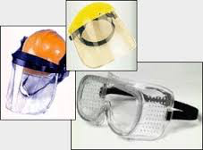
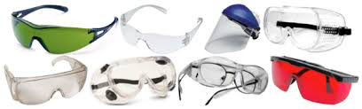
Selecting Eye and Face Protection
Safety glasses
Goggles
Face shields
Shaded filter lenses
Prescription eyewear
Must comply with ANSI Z87 specifications
Notes:
Slide Show Notes
The next part of the session talks about how to select the right PPE for different hazards, how to make sure it is worn properly, and how to take care of it. There are many choices and considerations in selecting eye and face protection.
Safety glasses with side protection are designed to protect against flying objects such as metal or wood chips.
Goggles protect the eyes both against flying objects and from floating dust, hazardous liquids, and chemical gases and vapors.
Face shields are needed to protect workers against chemical splashes, hot slag, flying debris, and molten metals. The face shield that is selected should be appropriate for the hazard.
Shaded filter lenses are worn to protect against potentially harmful light radiation, such as from welding operations or around certain laser equipment.
Prescription safety glasses may be appropriate for employees who need corrective eyewear. Wearing contact lenses is not recommended when exposed to such hazards as dust, chemicals, and high temperatures.
All approved eye and face protection should be marked “Z87,” meaning that it complies with the American National Standards Institute, or ANSI, standard for eye PPE.
Bring examples of the different types of eye protection that have been selected for each hazard identified in your company’s hazard assessment.

Slide 14

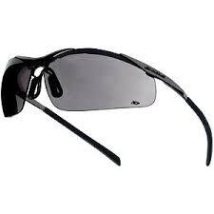

Wear and Care of Eye Protection
Fits comfortably
Does not distort or block vision
Put on before exposure to the hazard
Clean with soap and water
Dispose when scratched or damaged
Notes:
Slide Show Notes
Eye protection should be worn and cared for properly.
PPE for the eye and face should always fit comfortably. Eye wear shouldn’t pinch your nose or put pressure on your head. If it is not comfortable, employees will be less likely to wear it when they should.
Eye wear should not distort or block vision. If employees are experiencing dizziness or headaches from wearing eye protection, try another style or brand.
Eyewear should be put on before being exposed to a hazard. This may seem obvious, but many eye injuries occur each year because workers forget to put on their protective eyewear before starting a hazardous job.
Protective eyewear should be kept clean, and washed regularly with soap and water, or with special cleaning products. Regular cleaning helps make sure that vision is not blocked or blurred. If exposed to dust or liquid chemicals while wearing goggles, make sure to clean off the top rim of the goggles before removing them so that the dust or liquid does not drip or fall into the eyes when the goggles are removed.
Dispose of protective eyewear if scratched or otherwise damaged and it does not fit correctly, no longer protects against hazards, or distorts vision.

Slide 15
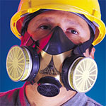
Selecting Respiratory Protection
Filtering face piece (dust mask) for dust only
Air purifying respirator is most common type
Choose cartridges carefully
Notes:
Slide Show Notes
As with protective eyewear, there are different kinds of respiratory protection that should be selected according to the kind of hazards involved.
A filtering facepiece, or dust mask, is worn to protect against inhaling dust. Employees exposed to low levels of dust may choose to wear a dust mask voluntarily. However, employees exposed to high levels of dust, or hazardous dust above permissible exposure limits, or PELs, are required to wear a filtering facepiece.
Air purifying respirators—either full-face or half-face—are the most common type of respiratory protection. These respirators use a cartridge or filter to purify the air being breathed, and provide protection against vapors and fumes. Air-purifying respirators must be worn by employees when monitoring shows that PELs have been exceeded. At levels below the PEL, employees may choose to wear a respirator.
Cartridges for air-purifying respirators should be chosen carefully. No type of cartridge will filter out all possible types of chemical contaminants, so it is important to select the right cartridge for the contaminant. In addition, it’s important to know how long it takes for a chemical to “break through” the cartridge; this lets you know how often the cartridge needs to be replaced.

Slide 16
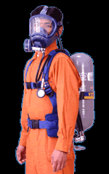
Selecting Respiratory Protection (cont.)
Air-supplied respirator for high chemical concentrations
Self Contained Breathing Apparatus (SCBA)
All respirators must be NIOSH-approved
Notes:
Slide Show Notes
Air-supplied respirators are used for high concentrations of chemicals or in atmospheres that do not have enough oxygen.
Self Contained Breathing Apparatus, or SCBA, is used under conditions that are immediately dangerous to life and health, such as in an emergency response to a serious chemical spill.
Remember, all respirators and filtering facepieces must be certified by the National Institute for Occupational Safety and Health, or NIOSH.
Bring examples of the different types of respiratory protection that have been selected for each of the hazards identified in your company’s hazard assessment.

Slide 17
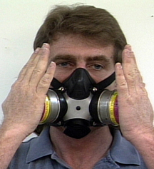
Wear and Care of
Respiratory Protection
Medical approval required
Conduct a fit test
Inspect before each use
Check the seal
Clean regularly
Store properly
Notes:
Slide Show Notes
The proper wear and care of respiratory protection is extremely important if it is to provide proper protection.
Medical approval is required for some types of respirators. The company’s Respiratory Protection Program includes information about the necessary medical approvals.
A fit test must be conducted at least annually for employees who are required to wear respirators. Fit testing involves using different ways to make sure the respirator seals to the wearer’s face properly.
Employees should always inspect their respirators before each use, checking parts such as the seal, head straps, valves, and cartridges for signs of cracking, wear, or other damage. Any damaged parts should be discarded and replaced.

Slide 18
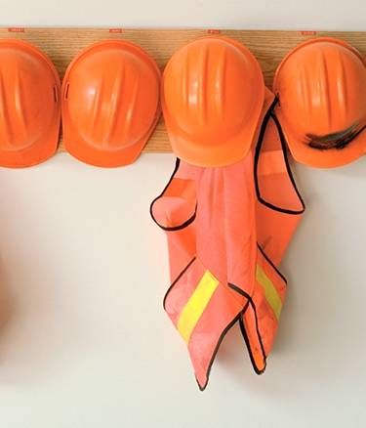
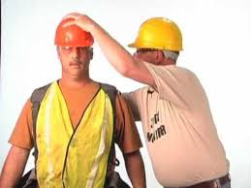
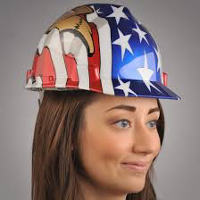
Selecting Head Protection
Hard hats protect from impact or penetration
Use electrical insulation hard hats
Use bump caps around low-hanging objects
Must comply with ANSI Z89 standard
Notes:
Slide Show Notes
As with other types of PPE, select head protection to match the kind of hazards workers are exposed to.
Hard hats protect the head from impact or penetration. They are usually made of high-density polyethylene so that they are lightweight, but strong enough to protect against falling objects.
Electrical insulation hard hats are used to reduce the risk of electrical shock and can protect against such hazards as power lines. Do not assume that a hard hat will protect against electrical hazard just because it is not made of metal.
Bump caps should be used around low-hanging objects such as pipes, steel structures, or machinery parts. However, bump caps are not intended to protect against falling objects or electrical hazards.
Hard hats in the workplace should be designed to meet ANSI standards and be marked with “Z89” to show that they meet these standards.
When discussing the selection of head protection, bring examples of the different types of head protection that have been selected for each of the hazards identified in your company’s hazard assessment.
If possible, have your safety supply vendor let you borrow a variety of different types of head protection for demonstration so employees can pick out the equipment that works best for them and meets the requirements of their jobs.

Slide 19

Wear and Care of Head Protection
Fit comfortably
Inspect before each use
Clean regularly
Used only to protect the head
Notes:
Slide Show Notes
Head protection needs to be worn correctly and cared for properly.
Head protection should fit properly. There are different kinds of suspension system for hard hats, and employees should know how to adjust the suspension so that the hard hat fits.
Inspect the hard hat before each use. Check for cracks or any other damage that might reduce the ability of the hard hat to provide protection. This includes inspecting the suspension system for cracks, worn straps, or other damage. Make sure the suspension system is installed properly, not backwards.
Clean hard hats regularly with soap and water.
Finally, hard hats should be used only for their intended purpose, which is to protect the head. They should not be used as a seat or a step stool, as this might damage them and reduce their ability to protect the head properly.

Slide 20
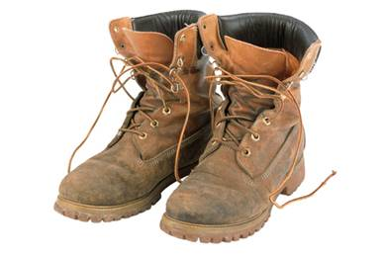
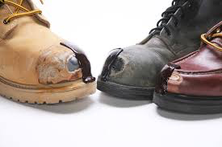
Selecting Foot Protection
Steel toes
Metatarsal protection
Puncture or slip - resistant soles
Chemical resistance
Waterproof and cold weather footwear
ANSI Z41
Notes:
Slide Show Notes
Selecting the right kind of foot protection is an important way to reduce the risk of serious injuries.
Steel-toed work boots or shoes will protect against rolling or falling objects that could crush a worker’s toes.
Some footwear provides metatarsal protection—that is, it protects the bones of the foot behind the toes. Other types of protective footwear provide steel in the heel and along the ankle to help keep the ankle from being twisted.
The sole of the shoe or boot can protect against different kind of hazards. Some soles are puncture-resistant, while slip-resistant soles should be worn on wet or slippery floors. Remember that surfaces with water on them require a different kind of slip-resistant sole than surfaces with oily substances.
Chemical-resistant boots are needed if there is a risk of splashing from liquid chemicals, acids, or caustics.
Waterproof and cold-weather footwear may be needed if workers are in wet, muddy, or cold conditions. Rain boots made of PVC or rubber can help keep feet dry. Special liners can help insulate feet against extreme cold.
Finally, protective footwear should be marked “Z41” to show that it complies with ANSI standards.
Bring examples of the different types of foot protection selected for each of the hazards identified in your company’s hazard assessment.

Slide 21
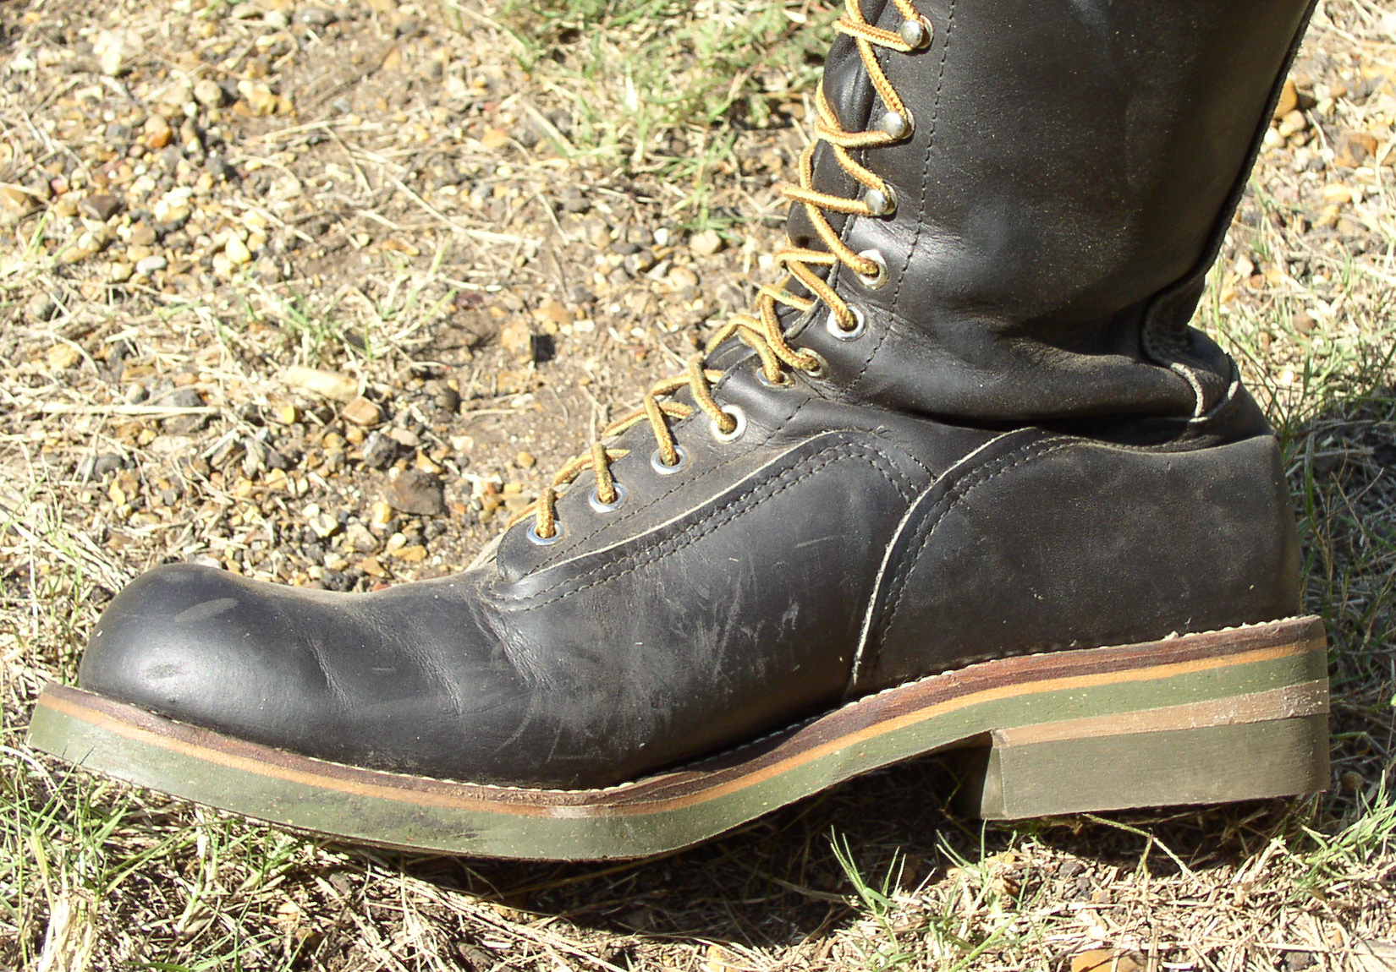
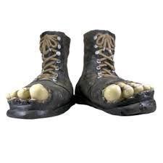

Wear and Care of Foot Protection
Should be comfortable
Inspected before each use
No cracks or holes in chemical or
waterproof boots
Soles checked for excessive wear
Kept clean
Notes:
Slide Show Notes
The proper wear and care of foot protection should not be taken for granted.
Protective footwear should be comfortable, just like everyday shoes.
It should be inspected before each use, to make sure it will provide the protection it is intended to provide.
Make sure that boots designed to protect against chemicals or other liquids do not have holes or cracks.
Soles should be checked for excessive wear, especially if they are intended to protect against slips or punctures.
Finally, protective footwear should be kept clean. Dirt, mud, and chemicals should be removed after each use to help keep the footwear in good condition.

Slide 22
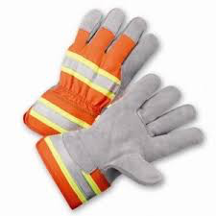

Selecting Hand Protection
Chemical- resistant gloves
Kevlar®, metal mesh, cut-resistant gloves
Leather work gloves
Extreme temperature gloves
Rubber Gloves rated for voltage appropriate for job
Notes:
Slide Show Notes
The right hand protection is essential for protecting a wide range of possible injuries.
Make sure that chemical-resistant gloves protect against the specific chemical being used. Chemical-resistant gloves can be made of rubber, latex, vuton, butyl, nitrile, neoprene, or PVC, and are graded by the manufacturer for degradation, breakthrough time, and permeation rate.
Gloves that are made of Kevlar® and metal mesh are resistant to cuts and punctures. These kinds of gloves should be worn when handling saws, knives, or glass.
Leather or canvas work gloves are commonly used to protect against cuts and scrapes. These can be coated with other materials that improve the grip.
Extreme temperatures of hot or cold require special gloves. Gloves made of terrycloth, leather, or pigskin help protect against burns. Gloves with liners are helpful when working in cold conditions.
Electricians need lineman’s gloves designed to protect against different levels of voltage. High-voltage gloves are black rubber with a red interior so that any cuts or damage to the outside layer can easily be seen. Liners are worn under these gloves to help absorb perspiration.
Bring examples of the different types of hand protection that have been selected for each of the hazards identified in your hazard assessment.

Slide 23
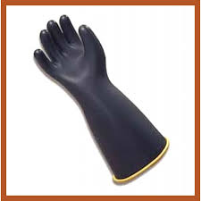
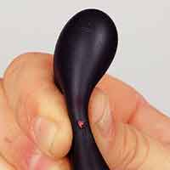
Wear and Care of Hand Protection
Comfortable fit
Inspect gloves before each use
Keep clean and dry
Discard if damaged or contaminated
Notes:
Slide Show Notes
As with all other kinds of PPE, proper wearing of and caring for hand protection is extremely important.
Protective gloves should fit comfortably. Gloves should not be too tight, which restricts hand movement, or too loose, which creates the hazard of being snagged or limits the ability to grip and feel properly.
Inspect protective gloves before each use. Check chemical-resistant gloves for cracks, holes, cuts, or other damage. Gloves that protect against cuts and punctures should not show wear or tear. Electrician’s gloves should not have any tears or scrapes. Aluminized heat-resistant gloves should not have abrasions on the outer surface or damage to inner linings.
Keep gloves clean and dry. Chemical-resistant gloves should be decontaminated after each use.
Finally, gloves should be discarded if they become damaged or contaminated.

Slide 24
Wear and Care of Arm Protection
Rubber protective sleeves
Inspect sleeves before each use
Rubber sleeves rated for voltage appropriate for the job
Discard if damaged or contaminated
Notes:
Slide Show Notes
As with all other kinds of PPE, proper wearing of and caring for hand protection is extremely important.
Protective gloves should fit comfortably. Gloves should not be too tight, which restricts hand movement, or too loose, which creates the hazard of being snagged or limits the ability to grip and feel properly.
Inspect protective gloves before each use. Check chemical-resistant gloves for cracks, holes, cuts, or other damage. Gloves that protect against cuts and punctures should not show wear or tear. Electrician’s gloves should not have any tears or scrapes. Aluminized heat-resistant gloves should not have abrasions on the outer surface or damage to inner linings.
Keep gloves clean and dry. Chemical-resistant gloves should be decontaminated after each use.
Finally, gloves should be discarded if they become damaged or contaminated.

Slide 25
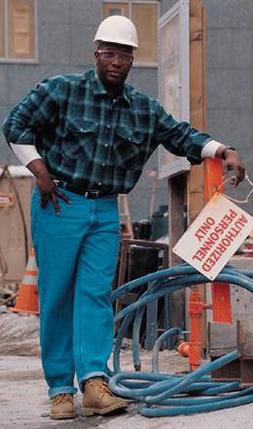
Selecting General Work Clothing
Long-sleeve shirts
and long pants
Flame-retardant clothing
No loose clothing or jewelry
Chemical-resistant clothing
Notes:
Slide Show Notes
As a final point about proper protection, make sure that general work clothing is selected in a way that guards against possible hazards.
Long-sleeve shirts and long pants help protect against skin damage from contact with hot or cold objects. Long-sleeve shirts and long pants also protect against sharp or rough materials that could cause cuts and abrasions. Working in cold conditions means wearing warm pants, coats, or jackets.
Flame-retardant clothing should be worn by welders or grinders who are exposed to sparks.
Loose clothing and jewelry should not be worn by workers who are exposed to moving machinery. The machinery might grab loose sleeves, ties, lapels, cuffs, watches, bracelets, or rings, and pull body parts into the machine.
Finally, chemical-resistant clothing should provide protection against the specific chemicals being used.
Clarify what clothing is and is not required to protect workers against the specific hazards in your workplace.

Slide 26
Selecting PPE—
Any Questions?
Do you understand how to select proper PPE?
Do you understand the proper use and care of PPE?
Notes:
Slide Show Notes
Do understand how to select proper PPE?
Do you understand the proper use and care of PPE?
It is important that you understand the material presented.

Slide 27
Key Things to Remember
Conduct a hazard assessment to ensure all parts of the body are protected
Conduct the assessment for each job, no matter how routine
Select the appropriate PPE for the hazard(s) identified
Know how to wear and care
for PPE
Ask questions, if confused about hazard assessment or how to protect yourself
Notes:
Slide Show Notes
Here are the key things to remember about conducting hazard assessments and selecting PPE:
First, conduct hazard assessments to ensure that all parts of the body are adequately protected.
Second, conduct and certify the hazard assessment for each type of job.
Third, select the appropriate kinds of PPE for all of the hazards that have been identified.
And finally, train employees how to wear and care for PPE.
This concludes the training session on Personal Protective Equipment.

Slide 28
PPE Requirements for Hazards
PPE requirements are described in the following standards:
  OSHA (29 CFR 1910) and subparts
  National Consensus Code
    National Fire Protection Association
    (NFPA 70E)
    American Society for Testing and Material (ASTM)
Notes:
Read the slide……..
OSHA 1910 Subpart I is Personal Protective Equipment. Electrical protective equipment is found in 1910.137
NFPA 70E has requirements for PPE including arc rated PPE.
ASTM and ANSI have requirements for PPE

