Slide 1
Safety Meeting Topics
Hand Tool Safety
Copyright by the Institute for Safety in Powerline Construction
3504 Parliament Ct.
Alexandria, LA 71303
All rights reserved. This material or any part thereof
may not be reproduced in any form without
the written permission of the
Institute for Safety in Powerline Construction

Slide 2
Learning Objectives
You will be able to:
Identify the hazards of hand tools
Understand common safety practices for specific types of tools
Take precautions against injury
Notes:
Slide Show Notes
By the end of the training session, you will be able to:
Identify the hazards of hand tools
Understand common safety practices for specific types of tools
Take precautions against injury

Slide 3
Types of Hand Tools
Hand tools include anything from axes to wrenches
Other common examples include screwdrivers, hammers, punches, handsaws, chisels, files, snips, axes, knives, box cutters, wrenches, pry bars, hooks, and pliers
Notes:
Slide Show Notes
Hand tools are nonpowered tools that require human force in order to function and include anything from axes to wrenches.
Other common examples of hand tools include screwdrivers, hammers, punches, handsaws, chisels, files, snips, axes, knives, box cutters, wrenches, pry bars, hooks, and pliers
Modify this slide to list the specific types of hand tools used at your facility.
Bring examples of the hand tools used at your workplace.

Slide 4
Hand Tool Hazards
Greatest hazards of hand tools result from misuse and improper maintenance
Using a screwdriver as a chisel and the tip breaks causing a puncture injury
Wooden handle is damaged and the head of the hammer flies off causing impact injury
Wrench, with jaws sprung, slips and your hand strikes another object, causing cut
Impact tool, such as a chisel, with a mushroomed head shatters into fragments
Notes:
Slide Show Notes
The greatest hazards posed by hand tools result from misuse and improper maintenance.
Using a screwdriver as a chisel may cause the tip of the screwdriver to break and fly, hitting the user or other employees.
If a wooden handle on a tool such as a hammer or an axe is loose, splintered, or cracked, the head of the tool may fly off and strike the user or another worker.
A wrench must not be used if its jaws are sprung, because it might slip.
Impact tools such as chisels, wedges, or drift pins are unsafe if they have mushroomed heads. The heads might shatter on impact, sending sharp fragments flying.

Slide 5
Hand Tool Hazards (cont.)
Cut from a knife or saw blade
Struck by flying debris
Puncture with a sharp tool
Abrasions and contusions
Musculoskeletal disorders (MSDs) from repetitive misuse of a tool
Notes:
Slide Show Notes
It is easy to overlook the hazards associated with using hand tools. However, hand tools cause thousands of workplace injuries each year. Some common hazards associated with hand tools are:
Cut or laceration from a knife, saw, or other tool with a blade
Being struck by flying debris from a shattered tool or from the material (e.g., wood shaving, metal sliver, rock chip) on which the tool is being used. This flying debris could strike your eye and cause a serious eye injury.
Puncture wounds from a pointed sharp tool such as a screwdriver.
Abrasions and contusions from striking your thumb with a hammer or from a slipping wrench when your knuckles strike a nearby object.
Repetitive misuse of tools (e.g., awkward grip, excessive grip, awkward position) can lead to musculoskeletal disorders (MSDs)
Give examples of injuries that occurred as a result of using a hand tool in your workplace.

Slide 6
Selecting the Right Tool
Consider the shape, size, and grip of the tool
Consider the quality of the tool
Use spark-resistant tools when working near flammable materials
Use insulated tools when working near electricity
Notes:
Slide Show Notes
Select the right tool for the Job;
Consider the shape and size of the tool and the handle or grip - the tool should be comfortable to hold and should fit your hand properly. Do not select undersized tools
Consider the quality of the tool. Cheaper tools are more likely to break, get damaged, or become dull. Select high-quality tools.
Iron and steel hand tools can generate sparks, which are dangerous around flammable substances. Instead, use spark-resistant tools made from brass, plastic, aluminum, or wood.
Use insulated tools when working around electricity. Select tools that are rated for the voltage you will be working near. Also, do not work on or near energized electrical equipment unless you are properly trained.

Slide 7
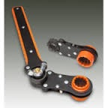
Consider Tool Ergonomics
Handles with no sharp edges or finger grooves
Handles coated with soft material
Handles with non-slip surfaces
Tools with angle for working with straight wrist
Tools designed to work in either hand
Spring-loaded to return to open position
Notes:
Slide Show Notes
Ergonomics is an important part of hand tool safety. Hand tool use in the workplace often involves repetitive motion, awkward body positioning, and the use of force—all are indicators of potential ergonomic injury. Select tools that can be used effectively with less force, less repetitive movement, and less awkward positioning of the body.
Select tools with handles that do not have any sharp edges or finger grooves. Finger grooves require you to place your fingers in a specific position on the handle, which may not fit your hand size properly.
Select tools with handles that are coated with a soft material so the force of a hard object is not placing contact pressure on your hand, which could cause ergonomic injury.
Select tools with non-slip handles to maintain a better grip.
Find tools that are angled appropriately to allow you to work with a straight wrist. Straight tools are not always the best option because you are required to put your wrist at an awkward angle in order to get the work done.
Select tools that are designed to work in either hand. You can prevent some of the repetition by switching hands.
Find double-handled tools that are spring-loaded to return to the open position so you do not have to open the tools as well as close them.

Slide 8
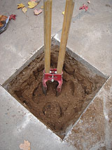
General Hand Tool Safety Practices
Make sure observers are at a safe distance
Clear the immediate work area
Keep area clutter free
Watch out for possible foot hazards
Examine tools before each use
Notes:
Slide Show Notes
Hand tool hazards and injuries can be avoided by practicing general hand tool safety:
Make sure no one is standing near you when you are using a tool unless they are wearing appropriate protective equipment. Anyone watching the work or working nearby could be injured.
Create a safe work area by removing objects that may get in the way or that you could strike if the tool were to slip.
Floors should be kept clean and dry to prevent slips or trips when using hand tools. It is important to have good footing.
Secure the material that you are working on with a vise, clamp, or other support. If the material moves, you could become injured. Do not attempt to hold the material yourself – too many injuries occur when this happens.
Examine tools before each use for defects or signs of damage.

Slide 9
General Hand Tool Safety Practices (cont.)
Wear PPE appropriate for the work
Keep cutting tools sharp and in good condition
Do not wear loose clothes or jewelry
Mark damaged tools clearly and notify your supervisor
Use protective work gloves
Notes:
Slide Show Notes
When using hand tools, wear appropriate personal protective equipment (PPE), including safety glasses, work gloves, work boots with steel toes, and tough work clothes.
Keep cutting tools sharp, well lubricated, and in good condition to be sure they work properly.
Never wear loose clothing or jewelry, and tie back long hair when using hand tools.
Mark damaged tools clearly and notify your supervisor.
Do not work with oily or greasy hands because you are likely to lose your grip on the hand tool, which could result in an injury.
Bring examples of PPE (personal protective equipment) used in your workplace when working with hand tools.

Slide 10
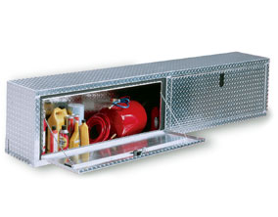
General Hand Tool Safety Practices (cont.)
Use the right size and type of tool for the job
Do not use tools that are loose or cracked
After using a tool, clean it and put it back in its proper place
Notes:
Slide Show Notes
Select the correct tool for the job and make sure it is the correct size needed for the job.
Do not use tools that are loose, cracked, or otherwise damaged.
Do not place tools on the edge of tables, work benches, or other flat surfaces. A co-worker could easily walk by that tool and be injured, especially if the tool has a sharp edge or blade.
After using a tool, clean it and put it back in its proper place. Cleaning the tool will help maintain it. Putting the tool back will also make it easier to find it next time you need it.

Slide 11
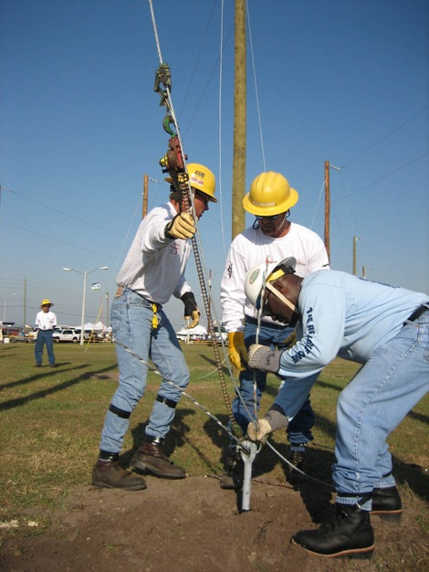
Carrying Tools
Toolbox, belt, or pouch
Never carry sharp tools in your pocket
Hold sharp edges or points away from body
Notes:
Slide Show Notes
Carrying Tools Safely;
Use a toolbox, toolholder, tool belt, or tool pouch to carry tools in order to protect yourself as well as the tool.
Never carry sharp or pointed tools in your pocket.
Carry sharp or pointed tools with the sharp edge or point away from your body. Just in case you slip or fall, you will not land on the sharp edge of the tool because it faces away from your body.

Slide 12
Carrying Tools (CONT.)
Don’t carry tools in your hand when climbing poles or ladders
Use a tool belt for storing tools
Hand tools to others, do not throw tools
Notes:
Slide Show Notes
Carrying Tools Safely;
Do not carry tools in your hand when climbing ladders. Use a belt, rope, or hoist.
Do not lay tools down in a walkway where someone can trip over them or on a high edge where they could fall on someone.
Hand tools to others, do not throw them, use a hand line or bucket to pass tools aloft.

Slide 13
Maintaining and Repairing Your Tools
Purchase quality tools
Inspect for damaged edges and handles
Keep edges and tips sharp
Replace damaged handles
Report broken or damaged hand tools
Discard damaged insulated tools
Notes:
Slide Show Notes
Avoid repair and maintenance costs by purchasing the best quality tools. Your tools will last longer and are less likely to be damaged from proper daily use.
Inspect tools for dull or damaged edges, and damaged handles or grips. Wooden handles must be kept free of splinters or cracks and be held tight in the tool.
Have a professional sharpen edges or tips of tools and blades.
Replace damaged handles or grips immediately.
If a tool breaks or malfunctions, report it to your supervisor.
Mark or tag damaged tools with “Do Not Use” in order to prevent a co-worker from using the tool and getting injured.

Slide 14
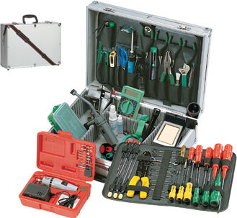
Screwdriver Safety
Use correct size head
Power grip handle should be 1-1/4” to 2” diameter
Precision grip handles should be 1/4” to 1/2” diameter
Do not use as a pry bar or chisel
Notes:
Slide Show Notes
When using a screwdriver:
Select the right type of screwdriver head for the task. Do not try to use a flat head to turn a Philips head screw.
Select the right size head screwdriver for the task. The head should fit perfectly into the head of the screw.
If the task requires a power grip, make sure the handle is 1-1/4” to 2” in diameter, does not have sharp edges, and has a soft surface. The correct handle size is needed to comfortably wrap your hand around the handle.
Precision handles should be 1/4” to 1/2” diameter to easily operate the screwdriver with your fingers.
Never use a screwdriver as a pry bar or chisel. You could bend the tip or shatter the handle.
Bring in screwdrivers commonly used in your workplace and demonstrate screwdriver safety.

Slide 15
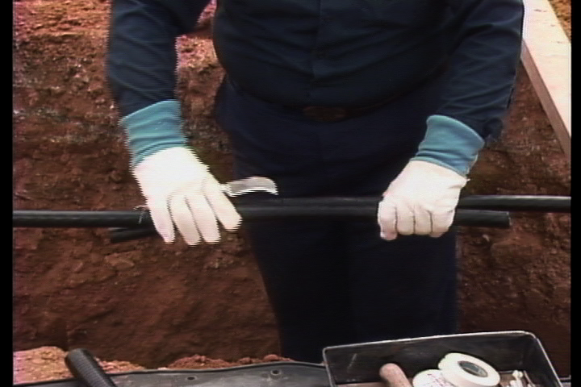
Knife Safety
Inspect the blade
Check the handle
Carry knife safely
Cut away from your body
Wear cut-resistant gloves
Secure object you are cutting
Notes:
Slide Show Notes
When using a knife:
Inspect the blade to make sure it is sharp.
Check the handle to make sure it is firmly attached to the blade and there are no signs of damage.
Carry the knife safely by either closing the knife or inserting the knife into its sheath. If necessary, carry an open knife down by your side with the blade pointed down and away from your body.
Always cut away from your body.
Wear a cut-resistant glove on your off-hand.
Secure objects you are cutting in a vice grip or in another way. Do not hold the object with your other hand—many knife-related injuries occur when the knife slips and cuts the hand holding the material being cut.
Bring in knives commonly used in your workplace and demonstrate knife safety.
When using a box cutter:
Inspect the blade to make sure it is sharp. Replace the blade if necessary.
Check the handle to make sure it is firmly attached to the blade, and there are no signs of damage.
Close the blade whenever the knife is not being used.
Always cut away from your body.
Wear a cut-resistant glove on your off-hand.
Secure work with a vice or clamp. Do not hold the object with your other hand—many box cutter-related injuries occur when the box cutter slips and cuts the hand holding the material being cut.
Bring in box cutters commonly used in your workplace and demonstrate box cutter safety.

Slide 16
Awl and Punch Safety
Inspect the point
Inspect the impact head
Hold punch straight up
Strike the head squarely with hammer
Awls should only be used for the design of the tool
Notes:
Slide Show Notes
When using a punch:
Inspect the point to make sure it is sharp and not damaged in any way. If necessary, have it sharpened.
Inspect the impact head to make sure it is in good condition. A mushroomed head is more likely to splinter or break when struck by the hammer.
Hold the punch straight up and down with one hand.
Strike it squarely with the hammer in your other hand.
Use awls for the design of the tool. (Screwdrivers are NOT awls.
Bring in punches commonly used in your workplace and demonstrate punch safety.

Slide 17
Hammer Safety
Inspect the handle for damage
Make sure hammer head is firmly attached to handle
Hold with a power grip
Keep other hand away
Notes:
Slide Show Notes
When using a hammer:
Inspect the handle for any signs of cracking, splits, etc.
Make sure the hammer head is firmly attached to the handle.
Hold the hammer with a power grip, which includes all of your fingers wrapped around the handle.
Keep your off-hand away from the hammer’s strike zone.
Bring in hammers commonly used in your workplace and demonstrate hammer safety.

Slide 18
Crow Bar and Pry Bar Safety
Inspect for signs of damage
Wear work gloves
Do not hammer into place unless the tool is designed for it
Pull in a smooth motion; do not jerk
Notes:
Slide Show Notes
When using a crowbar or pry bar:
Inspect the bar for any signs of damage, such as cracks.
Wear work gloves to protect your hands from metal spurs.
Do not hammer between objects unless the crow bar or pry bar is designed to be hammered into place.
Pull on the pry bar or crow bar in a smooth motion; do not jerk the crow bar. Jerking may cause whatever you are prying to break or splinter, and you could go flying in the direction of your motion.
Bring in crowbars and pry bars commonly used in your workplace and demonstrate crowbar and pry bar safety.

Slide 19
Wrench Safety
Inspect wrench jaws
Select non-slip, soft-coated handles
Turn wrenches toward your body
Clear area around wrench work
Do not use a “cheater bar” for leverage
Use work gloves
Notes:
Slide Show Notes
When using a wrench:
Inspect the jaws of the wrench. Wrenches, including adjustable, pipe, end, and socket wrenches, should not be used when jaws are sprung to the point that slippage occurs.
Select wrenches that have non-slip, soft-coated handles.
Turn wrenches toward your body because you have better control over the work.
When possible, try to clear the area around your wrench work in case the wrench slips or the object you are working on breaks loose. This will prevent your hand from smashing into a nearby object.
Do not use a “cheater bar” with a wrench to get the extra leverage you think you need.
Bring in wrenches commonly used in your workplace and demonstrate wrench safety.

Slide 20
Hydraulic Impact Wrench Safety
Inspect the fittings
Inspect the handle
Do not use if impact attachments are damaged
Wear safety glasses and hearing protection
Notes:
Slide Show Notes
When using a Hydraulic Impact Wrench:
Inspect the fittings, make sure there are no leaks in the hoses or fittings.
Inspect the handle and the impact head for any signs of damage.
Do not use if the impact head or attachments are damaged.
Wear safety glasses, gloves and possibly hearing protection.
Bring in hydraulic impact wrenches commonly used in your workplace and demonstrate inspecting and using them safely.

Slide 21
File Safety
Make sure blades are clean and sharp
Inspect the handle
File with a motion away from your body
Do not try to pry or hammer with a file
Notes:
Slide Show Notes
When using a file:
Make sure the file blades are clean and sharp.
If the file has a handle, inspect it for any signs of damage such as cracks or splinters.
File with a motion away from your body.
Do not try to pry or hammer with a file.
Bring in files commonly used in your workplace and demonstrate file safety.

Slide 22
Plier Safety
Inspect for damage
Use pliers with soft, non-slip grips
Use locking pliers when continuous force is needed
Select pliers that can be used in either hand
Notes:
Slide Show Notes
When using pliers:
Inspect the pliers for any signs of damage.
Use pliers that have soft, non-slip grip handles.
Use locking pliers if continuous force is needed to hold firmly to an object for a period of time.
Select pliers that can be used in either hand.
Bring in pliers commonly used in your workplace and demonstrate plier safety.

Slide 23
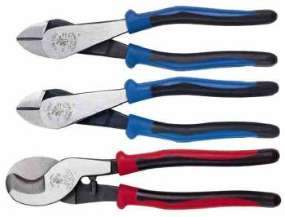
Side Cutter Safety
Blades are sharp
Handle grips must be in good condition
Spring-loaded handles should return to open position
Wear cut-resistant work gloves
Cut away from your body
Notes:
Slide Show Notes
When using hand snips or side cutters:
Blades should be sharp.
Handle grips should be in good condition to prevent slippage.
Spring-loaded handles should return to open position.
Wear cut-resistant gloves if cutting sheet metal.
Cut away from your body.
Bring in hand snips and side cutters commonly used in your workplace and demonstrate using them safety.

Slide 24
Bolt and Cable Cutter Safety
Inspect the blades & handle
Close the blades when not in use
Cut away from your body
Wear work gloves and safety glasses
Secure object you are cutting
Notes:
Slide Show Notes
When using bolt and cable cutters;
Inspect the blades and handles for defects
Keep the blades in the closed position when not in use
Cut the cables and wire so that the wire does not spring back and cut you
Wear gloves and safety glasses
Always secure the objects of both ends while cutting
Bring in bolt and cable cutters commonly used in your workplace and demonstrate using them safety.

Slide 25
Tree Saw Safety
Inspect handle for damage
Saw head is firmly attached to handle
Use power grip
Keep other hand away
Use extensions properly
Wear safety glasses and work gloves
Keep the blade protected when not in use
Notes:
Slide Show Notes
Tree Saw Safety:
Inspect the handle
Make sure the blade is firmly attached
Use a firm grip so that the saw does not slip
Keep hands and legs away from the cutting area
Wear Safety glasses and gloves when using a saw
Keep the blade protected when not in use
When using an axe:
Inspect the handle for any signs of cracking, splits, etc.
Make sure the axe head is firmly attached to the handle.
Hold the axe with a power grip, which includes all of your fingers wrapped around the handle.
Keep your off-hand away from the axe’s strike zone.
When using a 2-handed axe, make sure the area around you is clear of obstructions and other people. Stand with a wide stance and make sure you have good footing.
Swing in such a way that if you were to miss the object you are trying to chop, the motion of your swing would not bring the axe toward you and strike your body.
Bring in tree saws and axes commonly used in your workplace and demonstrate axe safety.

Slide 26
Handsaw Safety
Make sure the blade is sharp
Inspect the handle
Secure the object in a vise or clamps if possible
Cut in a smooth motion
Wear cut-resistant work gloves
Notes:
Slide Show Notes
When using a handsaw:
Make sure the blade is sharp. If not, sharpen the blade or replace it.
Inspect the handle on the handsaw for signs of damage.
Secure the object you are cutting in a vise or clamps.
Cut back and forth in a smooth motion.
Wear leather work gloves or cut-resistant gloves when handling saws.
Bring in handsaws commonly used in your workplace and demonstrate handsaw safety.

Slide 27
Key Points to Remember
Maintain tools
Use the right tool for the job
Examine each tool for damage before use
Operate tools in accordance with manufacturer’s instructions
Use the proper PPE
Notes:
Slide Show Notes
Keep all tools in good condition with regular maintenance.
Use the right tool for the job.
Examine each tool for damage before use and do not use damaged tools.
Operate tools in accordance with manufacturer’s instructions.
Wear the appropriate PPE.
If tool inspection sheets are available, pass around samples.

Slide 28
Hand Tools — Any Questions?
Any questions regarding selecting hand tools?
Any questions regarding the inspection and maintenance of hand tools?
Any questions regarding general hand tool safe practices?
Notes:
Slide Show Notes
Do you have any questions regarding selecting hand tools?
Do you have any questions regarding the inspection and maintenance of hand tools?
Do you have any questions regarding general hand tool safe working practices?

