Slide 1
Safety Meeting Topics
Emergency Action Plans
Copyright by the Institute for Safety in Powerline Construction
3504 Parliament Ct.
Alexandria, LA 71303
All rights reserved. This material or any part thereof
may not be reproduced in any form without
the written permission of the
Institute for Safety in Powerline Construction
©
Notes:
Slide Show Notes
Welcome to this training session on Emergency Action Plans (EAP’s). This session is intended for powerline crews working out in the field. Preparing for emergencies is often overlooked when performing Pre-job Briefings. Crew leaders sometimes assume that everyone knows what to do in a emergency. Or, they assume that since we talked about it last month, we don’t need to cover that topic again. What to do in case of emergencies should be discussed on every job, every time.

Slide 2
Introduction
Effective safety and health programs for mobile workforce personnel should include the development of Emergency Action Plans (EAP’s) in the event of:
Employee Injuries on the job
Fires, flashes and explosions
Chemical / Atmospheric emergencies
Hazardous waste emergencies
Vehicle accidents
Notes:
Slide Show Notes
The various types of emergency that can affect a powerline crew. Discuss examples of each in your own organization.

Slide 3
Session Objectives
After this training you should be able to:
Explain the importance of Emergency Action Plans
Describe how to establish an EAP for each job site
Demonstrate how to include a job-site specific EAP into a Pre-Job Briefing or ‘Tailgate’ Meeting
Notes:
Here are the main objectives of this session. What we want to accomplish over the next 30 to 45 minutes.

Slide 4
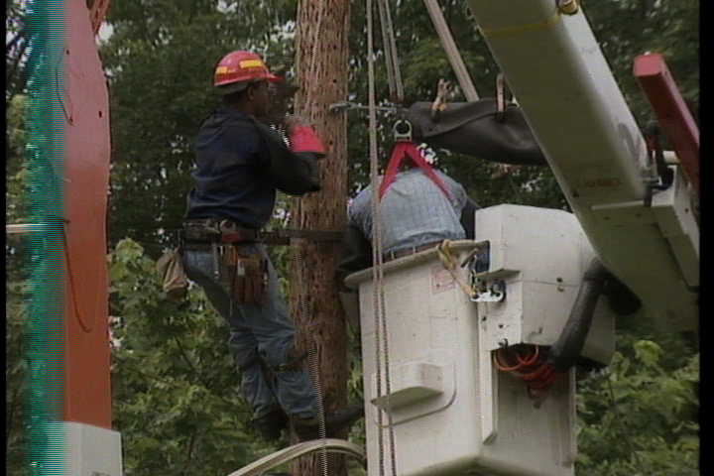
Elements of An Emergency Action Plan
Hazard Assessment
Preventive Safety Actions
Communicating the Plan
Responsibilities for the Plan
Notes:
Slide Show Notes:
Here are the components of an EAP that we’ll be discussing in more detail.

Slide 5
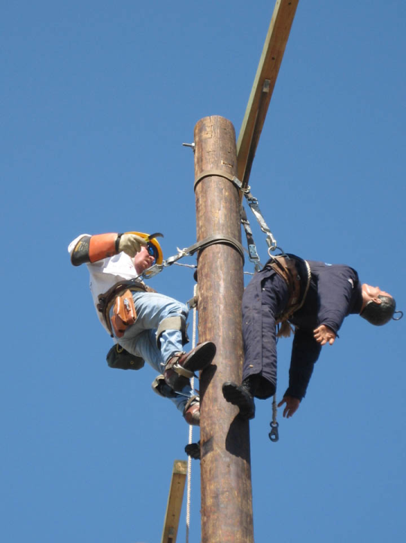
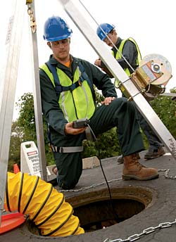
Hazard Assessment
Most powerline crews are mobile and every job-site can present a different series of potential hazards:
Electrical
Traffic
Falls, Falling Objects
Crushing / Struck-by Injuries
Atmospheric
Notes:
Slide Show Notes
Emergency action planning begins with a thorough understanding of risks and hazards we find on the jobsite, given the work assignment. Often, the hazards are multiple and begin to give us an idea of the severity of injuries we could possibly face given the work and the environment.

Slide 6
Hazard Assessment
Hazard Assessments are Job-Site Specific – each location has its own
Hazard Assessments identify all potential hazards – some may not be obvious
Hazard Assessments match a Preventive Safety Action to each hazard identified
Hazard Assessments result in written and communicated Emergency Plans for the site and the job at hand
Notes:
Slide Show Notes
Hazard assessments then help us identify they type of potential hazard we will have to mitigate and what type of injuries could occur if our mitigation practices don’t work. It’s better to overestimate the severity of what may happen, rather than ignore or underestimate the potential to injure. Then, after discussion, we document what emergency actions will take place should a particular type of accident occur.

Slide 7
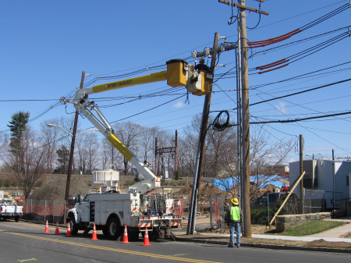
Hazard Assessment
For Example:
The assigned job requires a broken insulator to be replaced on a pole with lines that must remain energized. A bucket Truck will be used. It must be set up on the road in the north-bound traffic lane.
Notes:
Slide Show Notes
The next couple of slides provides a real-life example of what may be encountered on a job-site for a powerline crew. Involve the audience members in identifying the potential hazards on this job-site.

Slide 8
Hazard Assessment
Now: What all could go wrong? How could crew members get hurt, doing this job as assigned?
Hazard Assessment: Lacerations, Falling objects, Electrocution, Flash Burn, Boom contact with energized line energizing truck, Hydraulic system failure, Fall from Bucket, Moving vehicle hazards
Notes:
Slide Show Notes
How close did the audience come to the list show in the slide? Hopefully they found even more hazards than those listed here.

Slide 9
Preventive Safety Actions
Preventive Safety Actions:
Once the job Hazards have been fully assessed, each hazard must have a ‘Safety Action’ assigned to it. In other words, what action taken now, might either prevent an accident or minimize the severity of an accident associated with the hazard identified. For example, let’s look at the job under consideration with the hazards we’ve already identified:
Notes:
Slide Show Notes
Once hazards have been identified, what do we do next? How will be mitigate each hazard found, first of all. But then, assuming the worst, what emergency actions should we take if we do have an injury related to these hazards?

Slide 10
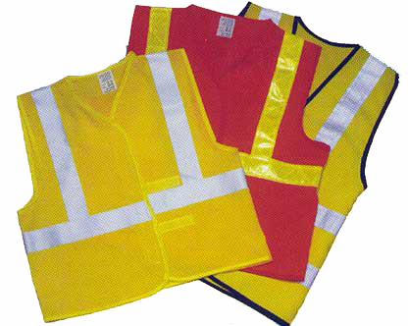
Preventive Safety Actions
Safety Action:
Standard PPE, Establish safe work-zone for traffic control, Request circuit ‘one-shot’, Ground & Barricade Bucket Truck, Use Bucket safety harness, Include Bucket escape system rigging packet, Full line and equipment cover-up, PPE to include rubber gloves, sleeves, Arc-Flash qualified clothing, face shield
Notes:
Slide Show Notes
This slide discusses various, typical ways of mitigating some of the hazards noted above. Can your audience list more?

Slide 11
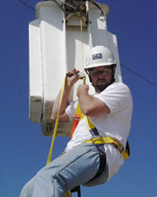
Preventive Safety Actions
Emergency Action Plans are actually one of the Safety Actions you will be taking
In the Example Job, given the Hazards identified and the Safety Actions listed, our Emergency Action Plan includes: Bucket Truck Rescue, Bucket Truck Escape, CPR/1st Aid, EMT assistance, Report to authorities
Notes:
Slide Show Notes
In the example job, here are several things we would prepare to do in any emergency – our EAP for this job-site.

Slide 12
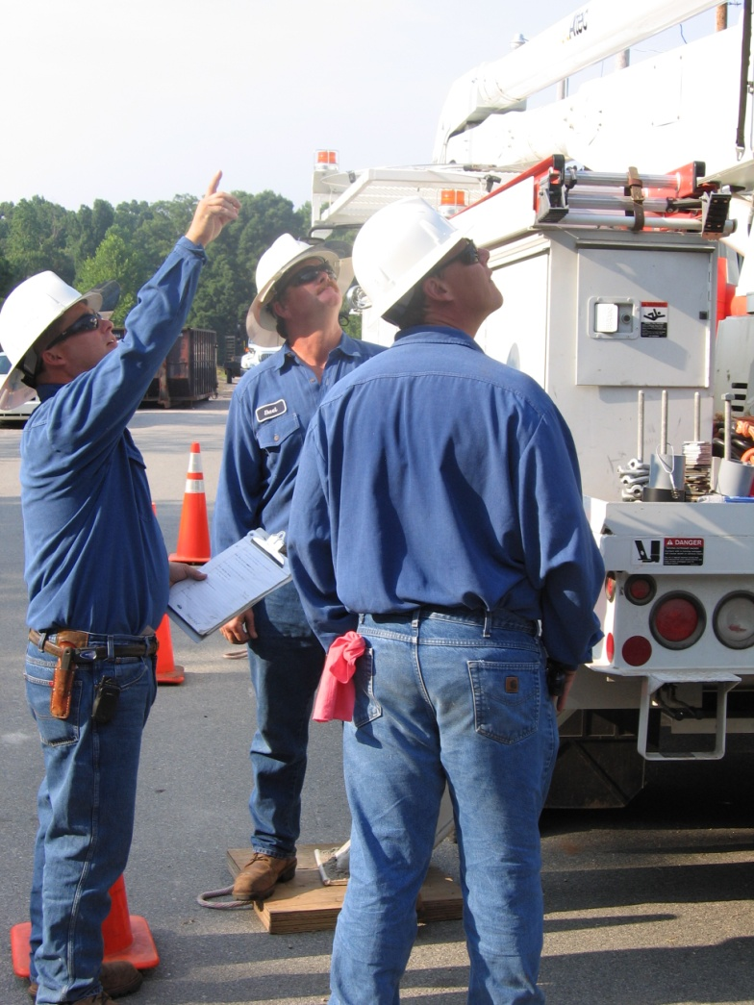
Communicating EAP’s
Pre-Job Briefings (Tailgate Meetings)
Emergency Action Plans must be communicated to the crew, prior to the job starting – and answer the questions: who, what, where and when.
Notes:
Slide Show Notes
Once the EAP is established, how will we communicate the plan and ensure everyone on the crew understands both the plan itself and their individual role within it.

Slide 13
Communicating EAP’s
Who, on the crew, will be responsible for each part of the plan
What will actually be done, prior to the job starting and during an emergency
Where will the actions take place
When and in what sequence will both the Safety Actions and the Emergency Actions happen
Notes:
Slide Show Notes
The Who, What, Where and When of communicating EAP’s

Slide 14
OSHA Regulations
1910.269 (c) (2) Job Briefing.
Subjects to be covered. The briefing shall cover at least the following subjects: hazards associated with the job, work procedures involved, special precautions, energy-source controls, and personal protective equipment requirements.
1910.269 (b) (1) & (i) & (ii):
First-aid training. When employees are performing work on, or associated with, exposed lines or equipment energized at 50 volts or more, persons with first-aid training shall be available as follows: For field work involving two or more employees at a work location, at least two trained persons shall be available.
1926.50 (c)
In the absence of an infirmary, clinic, hospital, or physician, that is reasonably accessible in terms of time and distance to the worksite, which is available for the treatment of injured employees, a person who has a valid certificate in first-aid training from the U.S. Bureau of Mines, the American Red Cross, or equivalent training that can be verified by
documentary evidence, shall be available at the worksite to render first aid.
Notes:
Slide Show Notes
OSHA regulations help us identify the specific areas of responsibility the Company has and the Crew Leader has, as well.

Slide 15
Any Questions?
Do you have any questions about:
What an Emergency Action Plan is?
When an Emergency Action Plan is required?
How to develop an Emergency Action Plan?
How to communicate an Emergency Action Plan?
Notes:
Slide Show Notes
Time to review and respond to questions on the material covered.

